Slide 1
Support for ICAP Layer
Yongsheng.guo@ansys.com

Slide 2
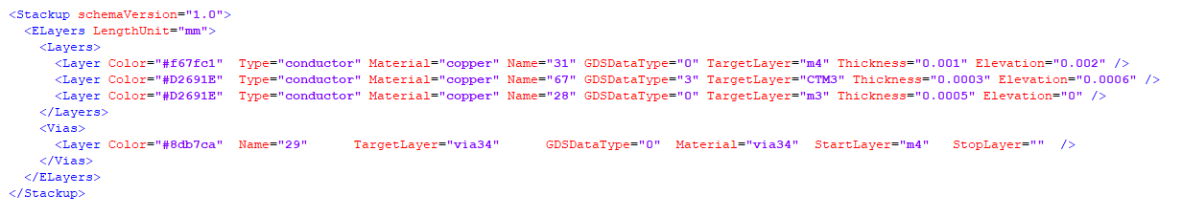
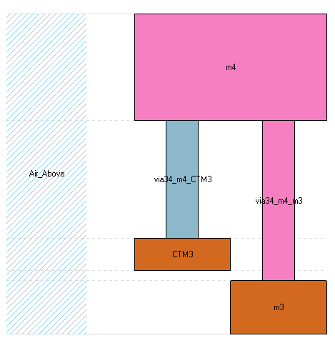
ICap support on Control XML
Only StartLayer is present.
without StopLayer value.

Slide 3
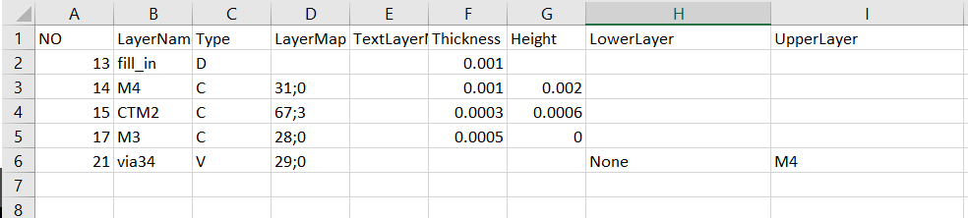
Icap xml syntax was support from GDS Import Wizard V5.6
CSVTech_overlapping_template.csv
Set LowerLayer to None to indicate the StopLayer not having value.
Options:
tech2xmlOption.json
"UseSheetLayer": false,
"FixedSmallLayerGap": 0,
"CreatViaGroups": false,
"AutoComps": false,
Must set for the small value in Thickness and Height
If viagroup not need
If Components not need

Slide 4
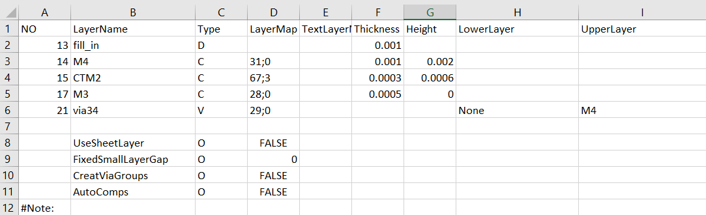
Options in CSV Tech, New in GDS Import Wizard V5.6
Options in CSV Tech with Type as O or (Option).
Options in CSV Tech have highest priority then GUI and any other ways, it should be used with caution, which may cause mismatch between GUI and finally effective.

